Slide 1
Empowering the nations

Slide 2
Empowering the nation
Empowering The Nation is a Johannesburg-based training initiatives founded in 2018 by Precious Radebe. The organization is dedicated to upskilling domestic workers and gardens offering both six-month Learnerships and six-week Short Skill Training Programmes. These courses equip participants with marketable skills, allowing them to seek better employment opportunities, command higher wages, or even start their own businesses . The training also benefits employers who want their staff to provide more specialized services. Empowering the Nation aims to uplift the community through education and professional development.

Slide 3

Local skills training Course
Next

Slide 4
Empowering the nation
Empowering The Nation was started by Precious Radebe in 2018 to help domestic workers and gardeners learn new skills. Precious Radebe saw how her parents and others never had the chance to get an education or improve their skills, so she wanted to change that for people in her community. We offer two types of training: Learnerships: Six-month programs that teach valuable skills over 12 marks. Short Skills Training: Six-week courses to quickly gain new abilities. These courses help you get better jobs, earn higher wages, or even start your own small business. Many employers also want their staff to have more skills, so our training makes you more marketable. If you take more than one course, you'll receive a discount: Two course- 5% off Three courses- 10% off Located in Johannesburg, Empowering the Nation has already trained hundreds of domestic workers and gardeners, helping them improve their lives. We make learning simple, affordable, and focused on your success.

Slide 5

Product benefits
Gardening & Cleaning.

Slide 6
Empowering the nation
Gardening services: Physical Health Benefits- Fresh air and exercise, Access to nutritious, homegrown produce. Reduced stress and anxiety. Improved mental health and mood.
Economic Benefits: Increased property value. Saving on grocery bills. Potential income through selling excess produce. Job creation and entrepreneurial oppotunities
Community Benefits: Community garden initiatives fostering social connections. Education and skill-sharing. Urban beautificatin and neighborhood pride. Enviromental sustainability
Cleaning services: Physical Health Benefits- Reduced allergens and asthma triggers. Improved indoor air quality. Decreased risk of pest-borne diseases. Better sanitation and hygiene.
Mental Health Benefit: Reduced stress and anxiety. Increased productivity and focus. Improved mood and overall well-being. Enhanced sense of control and organization.
Economics Benefits: Increased property value. Extended lifespan of belongings and appliances. Reduced replacement costs. Jobs created and economic growth.

Slide 7

Growth strategy
1. Develop a user-friendly website and social media presence.
2. Offer discounted services for first-time customers.
3. Partner with local nurseries and gardening supply stores.
4. Attend community events and gardening workshops.
5. Launch referral programs for existing customers.

Slide 8

Growth solutions
1. Develop a mobile app for booking and customer engagement.
2. Expand services to commercial clients (offices, restaurants, etc.).
3. Create a subscription-based model for regular gardening services.
4. Host workshops and webinars on sustainable gardening practices.
5. Establish strategic partnerships with local organizations and government initiatives.

Slide 9
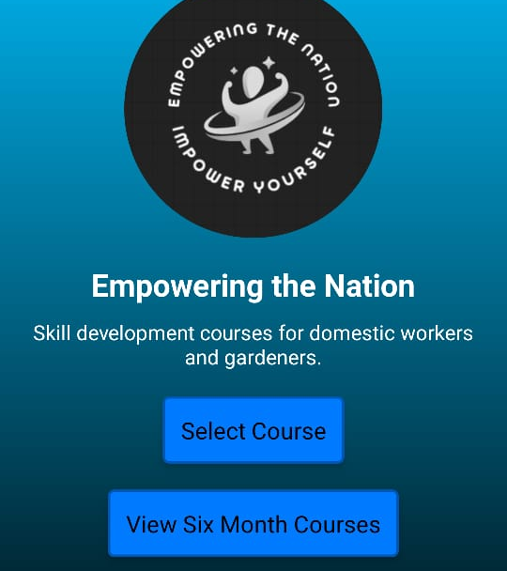
BENEFITS FOR CUSTOMERS
App:
1. Convenience: Easy booking and scheduling
2. Time-saving: Quick access to services and information
3. Personalization: Customized gardening and cleaning plans
4. Real-time updates: Service scheduling and status notifications
5. Exclusive offers: Discounts and promotions

Slide 10
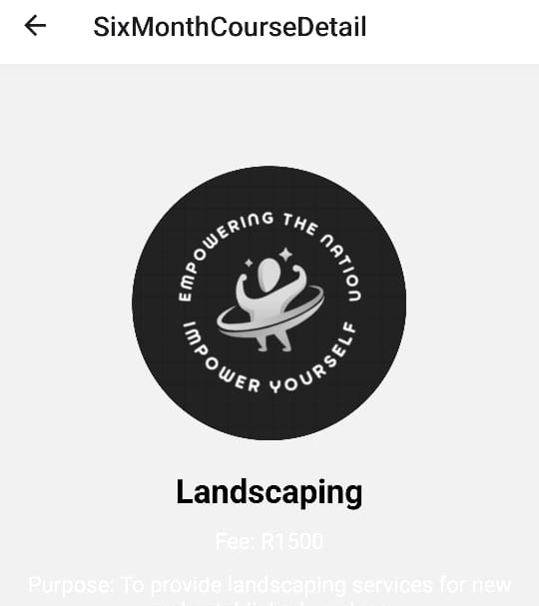
BENEFITS FOR CUSTOMERS
Website:
1. Information hub: Services, pricing, and company information
2. Easy contact: Simple contact form and phone number
3. Testimonials: Customer reviews and ratings
4. Blog: Gardening and cleaning tips, industry news
5. Online booking: Secure and convenient scheduling

Slide 11
Gains for the Company:
1. Revenue growth: Increased bookings, expanded services
2. Customer retention: Improved experience, personalized services
3. Operational efficiency: Automated scheduling, reduced admin tasks
4. Market competitiveness: Unique app and website offerings
5. Data-driven decision-making: Customer insights, behavior analysis

Slide 12
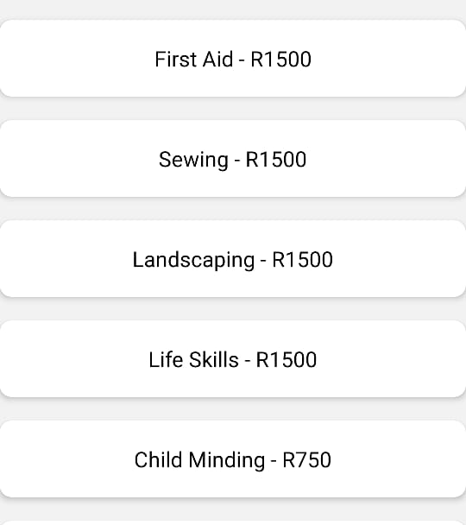
Common Growth Strategies:
1. Invest in customer service and satisfaction.
2. Monitor and adjust pricing strategies.
3. Continuously evaluate and improve operational efficiency.
4. Develop strategic partnerships with complementary businesses.
5. Stay up-to-date with industry trends and best practices.

Slide 13
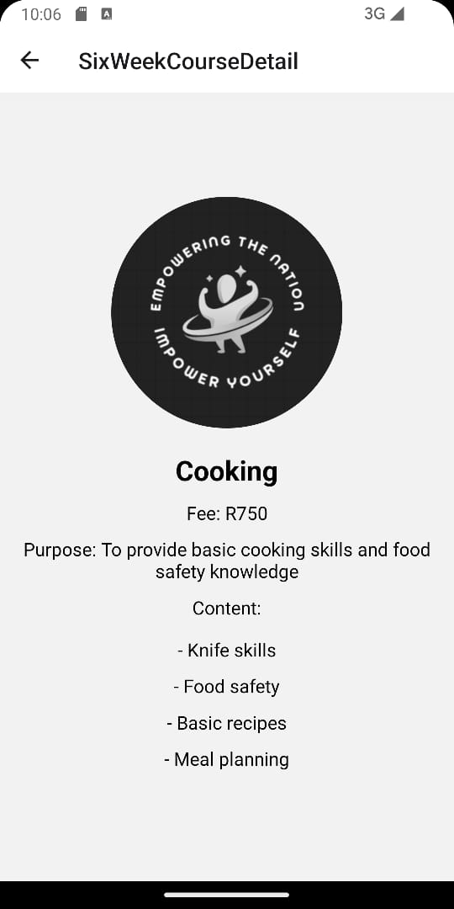
Key Performance Indicators (KPIs):
1. Revenue growth.
2. Customer acquisition and retention rates.
3. Customer satisfaction ratings.
4. Employee satisfaction and retention rates.
5. Online review and rating metrics.

Slide 14
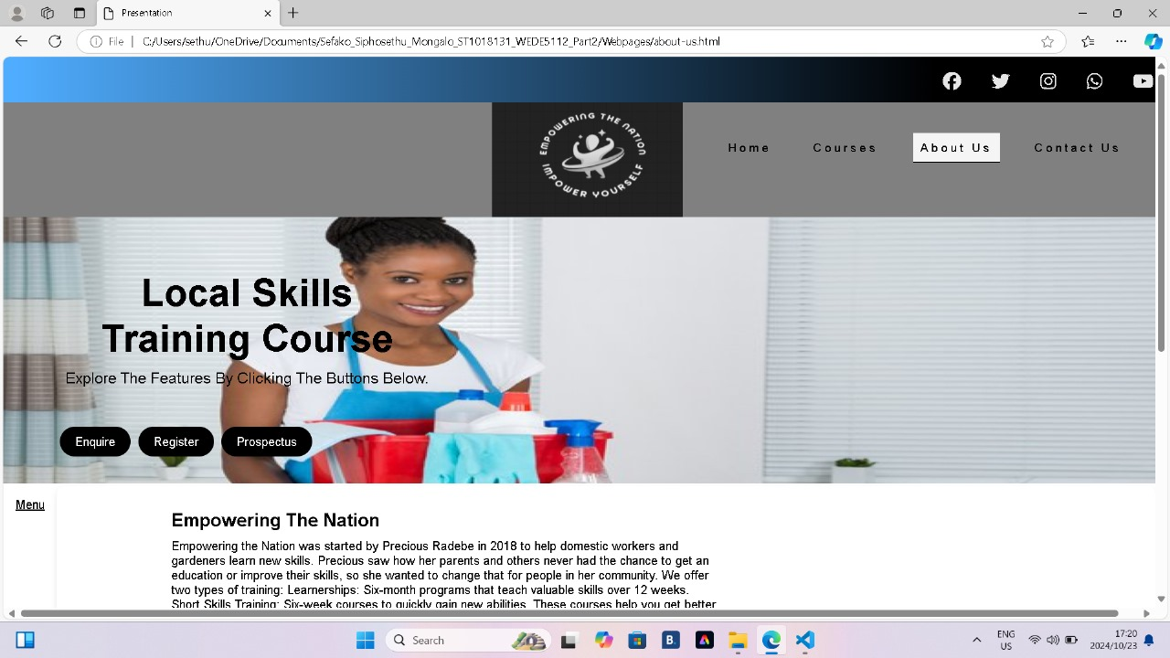
Budget Allocation:
1. Marketing and advertising (30%).
2. Staffing and training (25%).
3. Equipment and supplies (20%).
4. Technology and software (15%).
5. Miscellaneous (10%).

Slide 15

Conclusion:
By implementing these growth strategies, gardening and cleaning services can:
- Increase revenue and market share
- Improve customer satisfaction and retention
- Expand services and offerings
- Establish strategic partnerships and collaborations
- Stay competitive in the market
To ensure success, regularly review and adjust these strategies, monitor KPIs, and maintain a focus on customer satisfaction and operational efficiency.

Slide 16

Thank you
We hope you enjoyed

